Slide 1
ImageNet-trained CNNs are biased towards texture; increasing shape bias improves accuracy and robustness Robert Geirhos, Claudio Michaelis, Patricia Rubisch, Felix A. Wichmann, Matthias Bethge, Wieland Brendel mainly University of Tübingen (& IMPRIS-IS)
Fabrice Beaumont Rheinische Friedrich-Wilhelms-Universität Bonn
30.09.2020

Slide 2
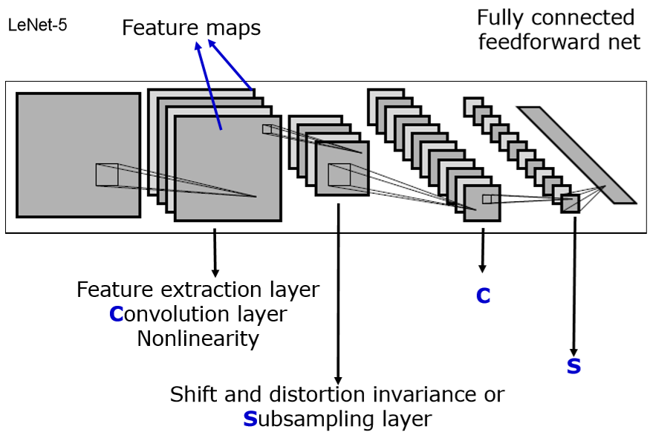
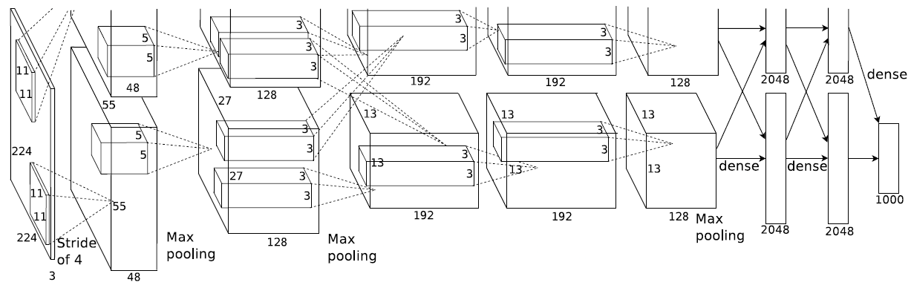
ImageNet-trained CNNs are biased towards texture; increasing shape bias improves accuracy and robustness )
(2012 - Alex Krizhevsky et al. – AlexNet)
Notes:
AlexNet
(KRIZHEVSKY, Alex; SUTSKEVER, Ilya; HINTON, Geoffrey E. Imagenet classification with deep convolutional neural networks. In: Advances in neural information processing systems. 2012. S. 1097-1105.)
APPLICATIONS:
Object recognition
Semantic segmentation
(e.g. for autonomous cars, facial recognition, medical imaging (recognizing chest cancer…))

Slide 3
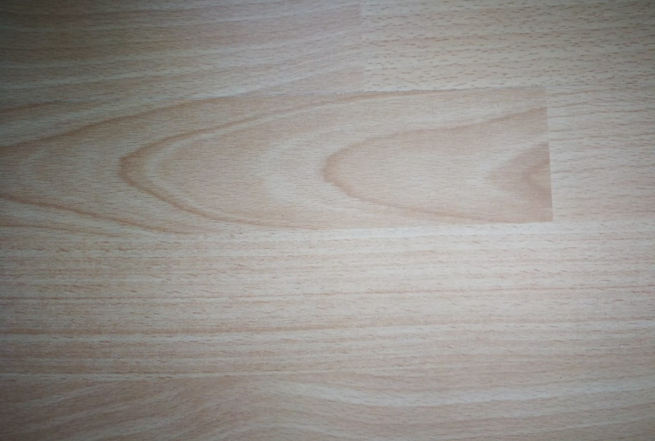
ImageNet-trained CNNs are biased towards texture; increasing shape bias improves accuracy and robustness )
(2012 - Alex Krizhevsky et al. – AlexNet)

Slide 4

ImageNet-trained CNNs are biased towards texture; increasing shape bias improves accuracy and robustness )
(2012 - Alex Krizhevsky et al. – AlexNet)

Slide 5
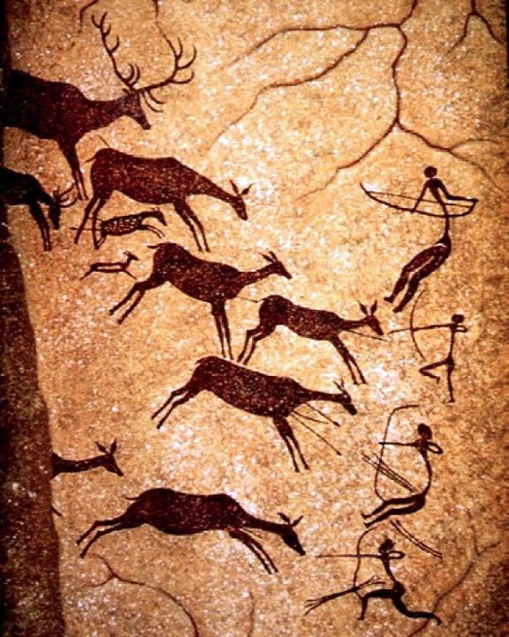
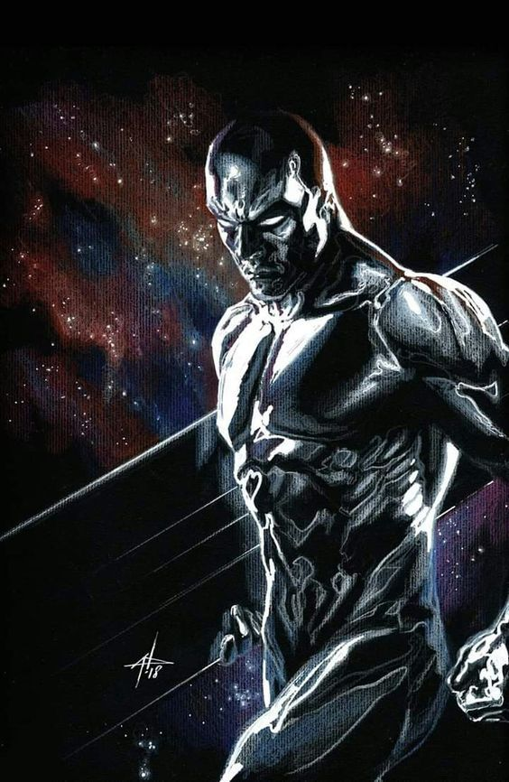
Motivation Importance of shape for object recognition
(2020; https://i.pinimg.com/564x/f5/bb/b4/f5bbb46820d7d3b9f41753f24db74516.jpg)
(2020; https://i.pinimg.com/564x/8e/34/f5/8e34f51699073da82c11d9995699498f.jpg)
1 / 26

Slide 6
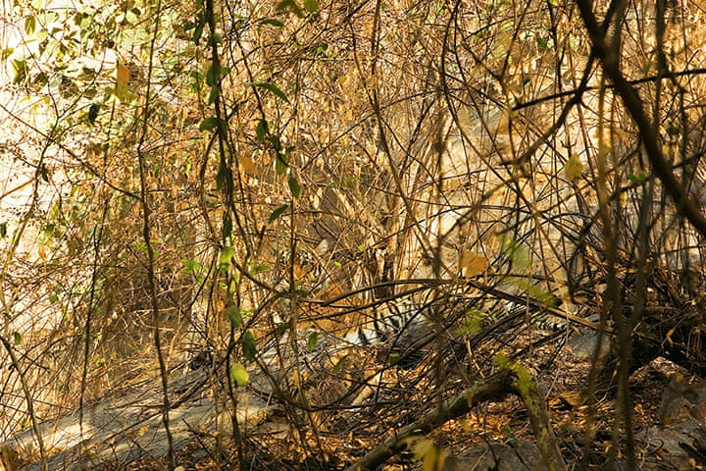
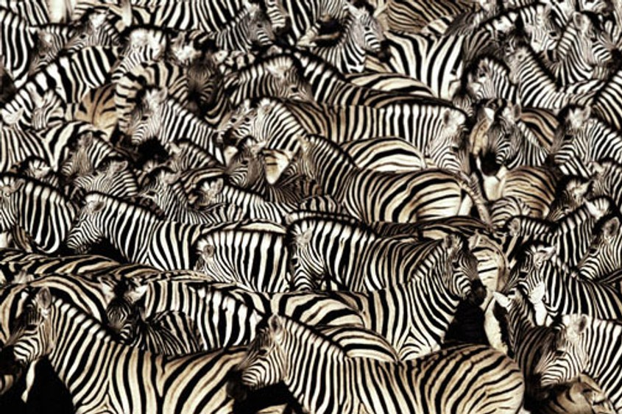
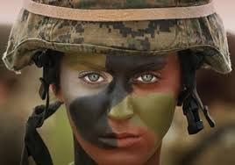
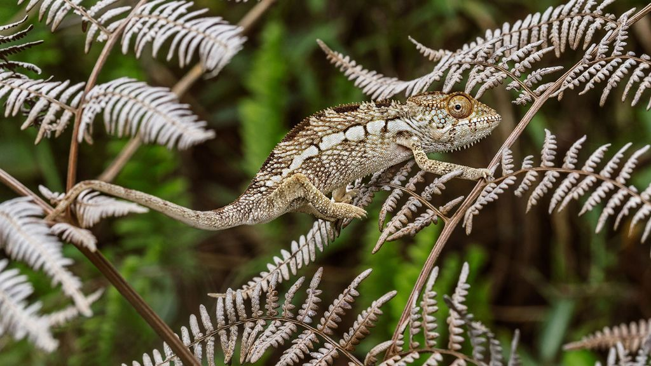
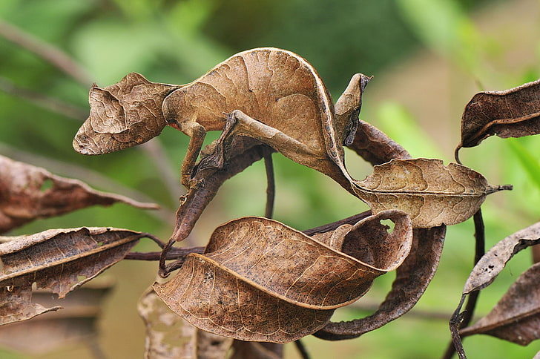
Motivation Importance of shape for object recognition
(2020; https://www.economist.com/img/b/1000/563/90/sites/default/files/images/print-edition/20120211_STP002_0.jpg)
(2020; https://i.redd.it/gmvyk1pz26p21.jpg)
(2020; https://i.pinimg.com/564x/84/e1/ 24/84e1240ca1d519a479310f24cc6a41e7.jpg)
(2020; https://static.nationalgeographic.de/files/styles/image_3200/public/chameleons-color-emotion-nationalgeographic_2298709.jpg?w=1024&h=576)
(2020; https://p4.wallpaperbetter.com/wallpaper/606/752/970/animals-reptiles-gecko-camouflage-wallpaper-preview.jpg)
1 / 26
Notes:
Usefullness of relying on shape:
Shape is more robust to natural distortions like: snow, rain (water), darkness, brightness
But: Shape is probably harder to „learn“, since
it comes in so many varieties. (perspectives, different poses of animals)
Texture for example stays more or less the same (if not removed by natural distortions)

Slide 7

Motivation
Humans (and other animals) excel at recognizing objects via their shape!
(Landau et al., 1988)
...But what about machines (here: CNNs)?
shape
texture
SHAPE
TEXTURE
1 / 26
Notes:
Why ask?: Understanding - Decisions of NN
- Human vision (neuroscience)

Slide 8
Introduction
Shape hypothesis: | CNNs learn to recognize and classify shapes
Support: | Zeiler & Fergus, 2014 Ritter et al., 2017 (contradicted by Hosseini et al. 2018)
“CNNs are ‘currently’ the most predictive model for human vental stream object recognition”
 | Landau et al., 1988 Cadieu et al., 2014 and Yamins et al., 2014 Kubilius et al., 2016
1 / 26
Notes:
Zeiler & Fergus, 2014: Visualisation techniques like Deconvolutional Networks often highlight object parts in high-level CNN (learned) features
Ritter et al., 2017 CNN “shape bias” (like human children): shape more important than colour (for object classification) (contradicted by Hosseini et al. 2018) CNN perform bad on inverted images – where the shape is untouched!
Landau et al., 1988 Shape = most important cue for human (2-/3-year-olds & adults) object recognition (over size/texture) – may be induced by language
Cadieu et al., 2014 & Yamins et al., 2014 CNN ~ predictive model for human ventral stream object recognition
Kubilius et al., 2016 CNN ~ model of human shape perception

Slide 9
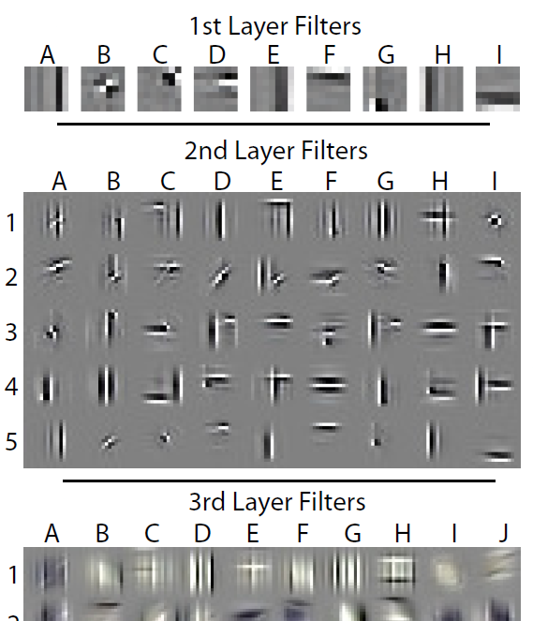
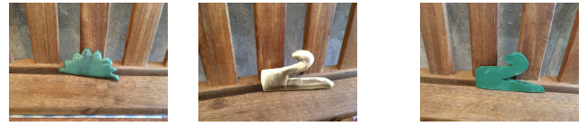
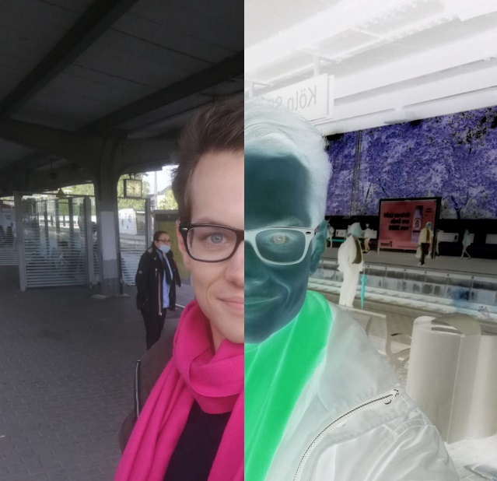
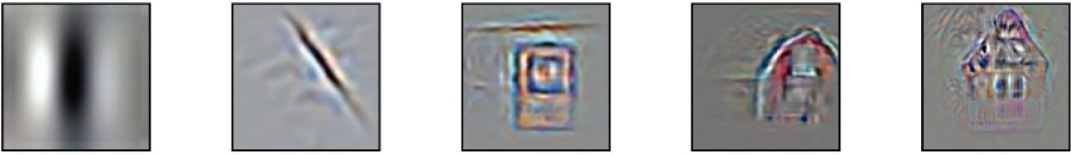
Introduction
Color match
Shape match
Probe
Shape hypothesis: | CNNs learn to recognize and classify shapes
Support: | Zeiler & Fergus, 2014 Ritter et al., 2017 (contradicted by Hosseini et al. 2018)
“CNNs are ‘currently’ the most predictive model for human vental stream object recognition”
 | Landau et al., 1988 Cadieu et al., 2014 and Yamins et al., 2014 Kubilius et al., 2016
(Ritter et al., 2017)
(Zeiler & Fergus, 2014)
Normal
Inverted
Layer 1
Layer 2
Layer 3
Layer 4
Layer 5
(Kriegeskorte (Ann. Review Vision Science 1:417-46), 2015)
1 / 26
Notes:
Idea of the „shape hierarchy“ – simple to complex
Zeiler & Fergus, 2014: Visualisation techniques like Deconvolutional Networks often highlight object parts in high-level CNN (learned) features
Ritter et al., 2017 CNN “shape bias” (like human children): shape more important than colour (for object classification) (contradicted by Hosseini et al. 2018) CNN perform bad on inverted images – where the shape is untouched!
Landau et al., 1988 Shape = most important cue for human (2-/3-year-olds & adults) object recognition (over size/texture) – may be induced by language
Cadieu et al., 2014 & Yamins et al., 2014 CNN ~ predictive model for human ventral stream object recognition
Kubilius et al., 2016 CNN ~ model of human shape perception

Slide 10
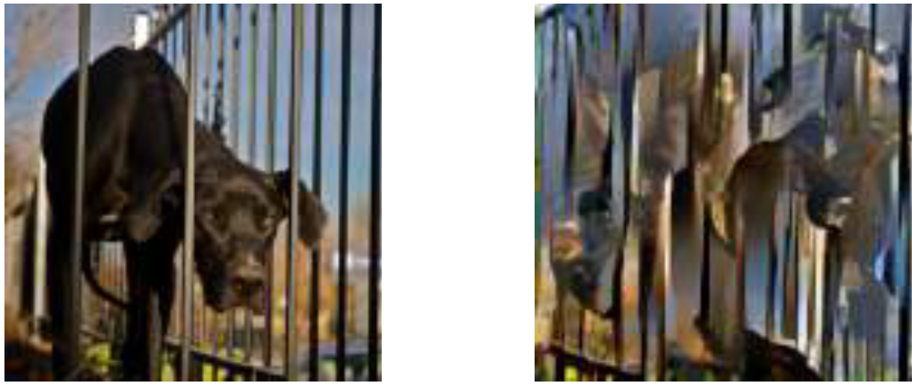
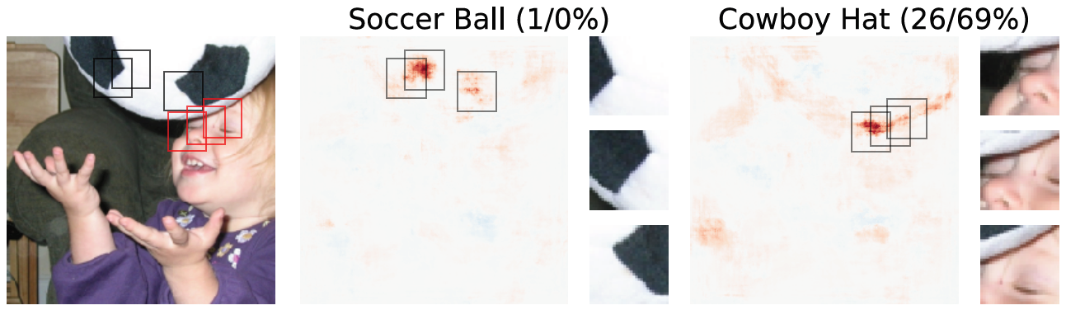
Introduction
Texture hypothesis: | CNNs learn to recognize and classify textures
Support: | Gatys et al., 2015 and 2016 Gatys et al., 2017 and Brendel & Bethge, 2019 Eckstein et al., 2017 Wollis et al., 2017 and Laskar et al., 2018 and Long & Konkle, 2018 Funke et al., 2017 Geirhos et al., 2018 Gondal et al., 2018 Gokaslan et al., 2018 Ustyuzhaninov et al., 2018 Brendel & Bethge, 2019 Ballester & de Aruújo, 2016; Yu et al., 2017
(Brendel & Bethge, 2019)
(Geirhos et al., 2018)
2019; Brendel & Bethge
(Ballester & de Aruújo, 2016)
1 / 26
Notes:
Gatys et al., 2015 linear classifier on top of a CNNs texture representation performs well
Gatys et al., 2016 CNNs robust to style transfer (texture-based generative modelling)
Gatys et al., 2017 and Brendel & Bethge, 2019 CNNs robust to destroyed global shape structure of texturized images
Eckstein et al., 2017 CNNs robust to changed object size relative to context
Wollis et al., 2017 and Laskar et al., 2018 and Long & Konkle, 2018 CNNs perform similar to human-like texture representations but not human-like contour repress.
Funke et al., 2017 CNNs robust to static & dynamic texture synthesis (texture-based generative modelling)
Geirhos et al., 2018 CNNs robust to changed object colour relative to context
Gondal et al., 2018 CNNs robust to single image super-resolution (texture-based generative modelling)
Gokaslan et al., 2018 CNN based shape transfer seems to be difficult
Brendel & Bethge, 2019 CNNs robust to scrambled shapes
Ballester & de Aruújo, 2016; Yu et al., 2017 CNNs susceptible to missing texture information
Ustyuzhaninov et al., 2018 Segmentation model trained on database of synthetic texture images transfers to natural images and videos

Slide 11
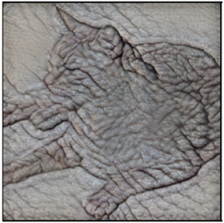
Results - Overview
1. CNNs (mostly) use textures for the classification task
2. This texture-bias can be replaced by a shape-bias by using a suitable database
3. CNNs with a shape-bias are more robust to (unseen) noise
(Geirhos et al., 2019)
1 / 26

Slide 12
Result 1
1. CNNs (mostly) use textures for the classification task
Idea: Remove textures in the images while preserving shape
Method: Style-transfer (Huang & Belongie, 2017)
(Geirhos et al., 2019)
1 / 26

Slide 13
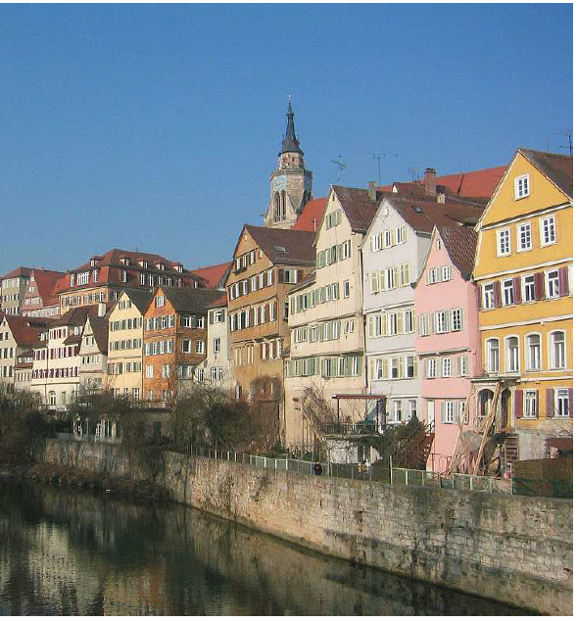
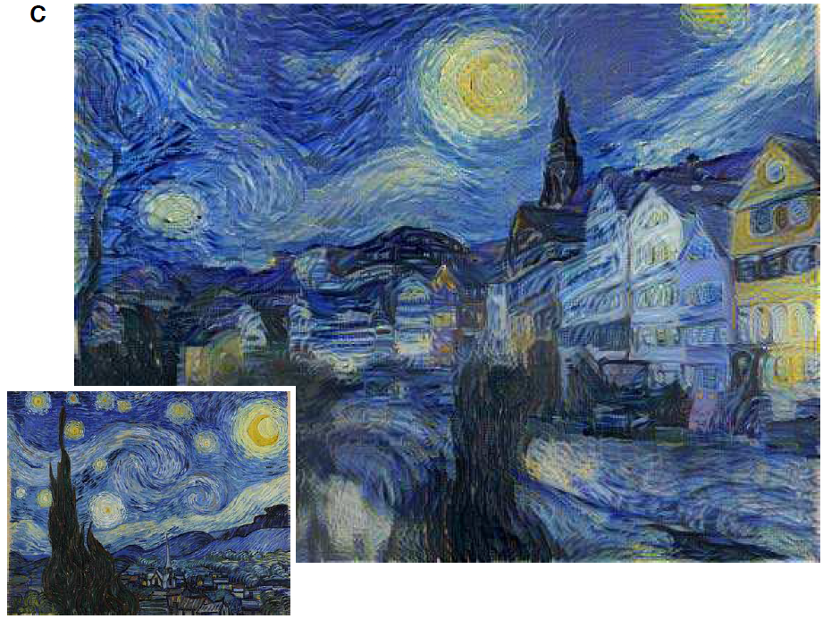
Result 1 Style-transfer
Shape
Style
Style-transfer
(Gatys et al., 2016)
1 / 26
Notes:
Originally intrudced by Gatys et al. (2016)
(But Huang & Belongie, 2017 is faster)

Slide 14
Result 1 Style-transfer
Shape
Style
Style-transfer
(Gatys et al., 2016)
1 / 26

Slide 15
Result 1 Texture-shape cue conflict
Shape
Style
Texture
Style-transfer
1 / 26

Slide 16
Result 1 Texture-shape cue conflict
Shape
Style
Texture
Style-transfer
Texture-shape cue conflict
1 / 26

Slide 17
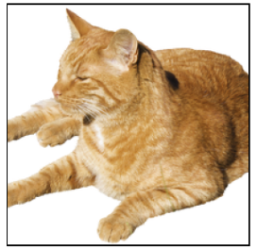
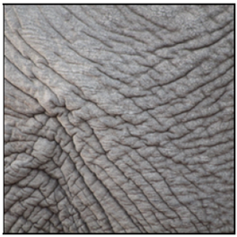
Result 1 Texture-shape cue conflict
Shape
Texture
Texture-shape cue conflict
(Geirhos et al., 2019)
1 / 26

Slide 18
Result 1 Texture-shape cue conflict
Shape
Texture
Texture-shape cue conflict
(Geirhos et al., 2019)
1 / 26
Notes:
(Figure 1)

Slide 19

5 Experimental set-up ImageNet
WordNet hierarchy
100.000 synsets
Average of over 500 images / node
(2020; http://www.image-net.org; snapshot)
13 / 26
Notes:
WordNet = lexical database of English (Princeton University)

Slide 20
Experiments Setup
48 560 trials, 97 humans
Following the paradigm for comparability of human & machine experiments (by Geishos et al., 2018)
Only use images which where sampled correctly by the CNN
13 / 26

Slide 21
Experiments Setup
Fixation square
300 ms
13 / 26

Slide 22

Experiments Setup
300 ms
Stimulus image
300 ms
13 / 26

Slide 23
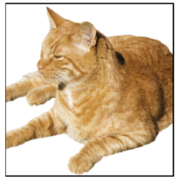
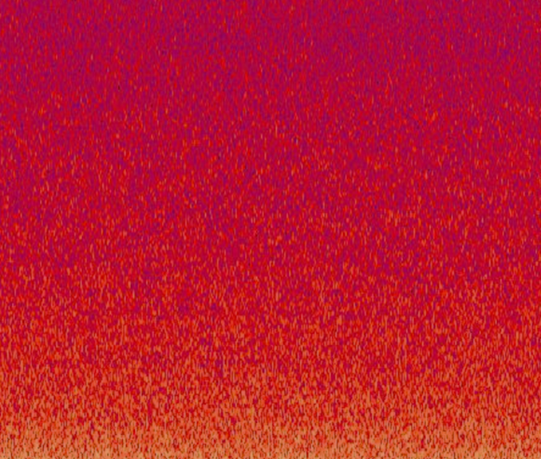
Experiments Setup
300 ms
300 ms
Full-contrast pink noise mask
200 ms
(2020; https://upload.wikimedia.org/wikipedia/commons/7/76/Noise.jpg)
13 / 26
Notes:
Minimization of the feedback processing in the human visual system
(CNN is „just feed-forward“, too)

Slide 24
Experiments Setup
300 ms
300 ms
200 ms
Click at the category “Guess if unsure“
1500 ms
(2020; https://upload.wikimedia.org/wikipedia/commons/7/76/Noise.jpg)
13 / 26
Notes:
The categories are known and represented by pictograms

Slide 25
Experiments Setup
300 ms
300 ms
200 ms
1500 ms =1.5 sec!!
airplane | bear | bicycle | bird
boat | bottle | car | cat
chair | clock | dog | elephant
keyboard | knife | oven | truck
= 16-class-ImageNet (Geirhos et al., 2018)
(2020; https://upload.wikimedia.org/wikipedia/commons/7/76/Noise.jpg)
13 / 26

Slide 26
Experiments Setup
AlexNet (Krizhevsky et al., 2012)
97 Humans
vs
GoogLeNet (Szegedy et al., 2015)
VGG-16 (Simonyan & Zisserman, 2015)
ResNet-50 (He et al., 2015)
13 / 26

Slide 27
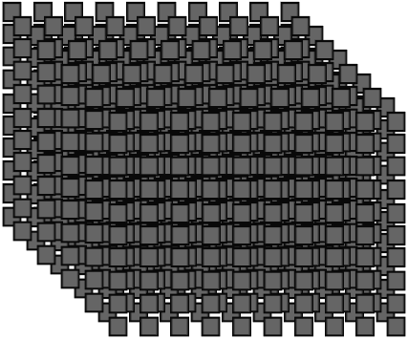
Experiments Setup
AlexNet (Krizhevsky et al., 2012)
97 Humans
vs
GoogLeNet (Szegedy et al., 2015)
VGG-16 (Simonyan & Zisserman, 2015)
ResNet-50 (He et al., 2015)
“WordNet hierarchy“
(Miller, 1995)
1000 classes
13 / 26

Slide 28
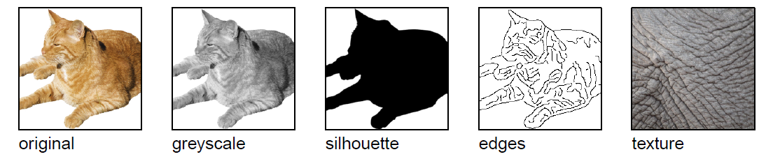
Experiments Setup
GoogLeNet
AlexNet
ResNet-50
VGG-16
x160
x160
x48
x160
x160
x1280
Original
Greyscale
Texture
Silhouette
Object shape
Texture-shape cue conflict
(Geirhos et al., 2019)
13 / 26
Notes:
Original: natural colour images, white background (160 images = 10 per one of the 16 categories)
Greyscale: (skimage.color.rgb2gray)
Silhouette: convert to .bmp (command line), convert to .svg (using potrace), convert to .png (command line) + manually checking every image and correcting using GIMP if necessary
Object shape: edge based representation/ describe 3D contours (Canny edge extractor (MATLAB))
Texture: 48 natural colour images of textures (3 per one of the 16 categories) – „full-width patches of animal (skin, fur) or repeted man-mad objects“ (e.g. Bottles see top slides)
CNNs had problems to shift from natural images (training data) to sketches (“silhouette“, “object shape“)
CNNs use texture for object classification
(Figure 2 – and kind of 1)

Slide 29
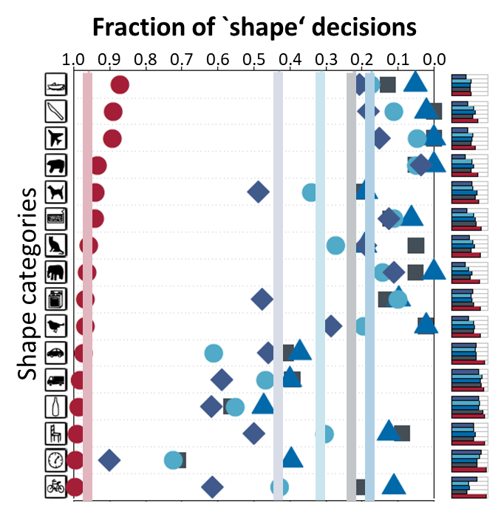
Experiments Setup
shape
texture
AlexNet
GoogLeNet
VGG-16
ResNet-50
(Geirhos et al., 2019)
13 / 26
Notes:
Similar results for: - ResNet-152
- DenseNet-121
Squeezenet1_1
(Missing legend/explenation in the github)
(Figure 4)

Slide 30
Results - Overview
1. CNNs (mostly) use textures for the classification task
(Geirhos et al., 2019)
1 / 26
Notes:
Goal: Induce shape bias? (like human) Treat texture as nuisance factor
(Overall parameters: Architectural changes, use of loss function, database selection)
Hidden Assumption: Texture-bias is NOT by design of the CNN
The database allowed to use this texture-shortcut (in both training and texting database!!)

Slide 31
Results - Overview
1. CNNs (mostly) use textures for the classification task
2. This texture-bias can be replaced by a shape-bias by using a suitable database
(Geirhos et al., 2019)
1 / 26

Slide 32
Results - Overview
1. CNNs (mostly) use textures for the classification task
2. This texture-bias can be replaced by a shape-bias by using a suitable database
Idea: Adapt the ImageNet database
Method: Style-transfer (AdaIN, Huang & Belongie, 2017) to replace the database with images of preserved shape but unreliable texture
(Geirhos et al., 2019)
1 / 26
Notes:
AdaIN – Adaptive Instance Normalization layer – „arbitrary style transfer in real-time“
Why not use Gatys stlye transfer?
use different stylization techniques (Huang&Belongie for training, Gatys for testing)
Gatys method is slower (iterative optimization process)
(Code to create SIN is avaliable on github.)

Slide 33
5 Experimental evaluation
ImageNet (IN) → Stylized ImageNet (SIN)
Texture: Kaggle‘s “Painter by Numbers“ data set
IN
SIN
(Geirhos et al., 2019)
13 / 26
Notes:
Replace IN-image with exactl ONE random stylized image
(Style transfer – Huang & Belongie, 2017 – (AdaIN)
(Painter by Numbers data set = 79.434 paintings
(Figure 3)

Slide 34
5 Experimental evaluation
ResNet-50 top-5 accuracies |  | Trained on
 |  | IN | SIN
Evaluated on | IN | 92.9 %
 | SIN |  | 79,0 %
26 / 26
Notes:
→ Learning on SIN is harder than on IN

Slide 35
5 Experimental evaluation
ResNet-50 top-5 accuracies |  | Trained on
 |  | IN | SIN
Evaluated on | IN | 92.9 %
 | SIN | 16.4 % | 79,0 %
26 / 26
Notes:
→ Learning on IN poorly generalizes to SIN

Slide 36
5 Experimental evaluation
ResNet-50 top-5 accuracies |  | Trained on
 |  | IN | SIN
Evaluated on | IN | 92.9 % | 82.6 %
 | SIN | 16.4 % | 79,0 %
26 / 26
Notes:
Learning on SIN generalizes well to IN
Further evaluation of effectiveness of SIN: - BadNets performance dropped from 70% (IN) to 10% (SIN) [ResNet-50 with limited receptive field, Brendel&Bethge 2019]
(= Table 1)

Slide 37
Experiments Setup
shape
texture
On IN:
AlexNet
GoogLeNet
VGG-16
ResNet-50
(Geirhos et al., 2019)
13 / 26
Notes:
OLD statistic – IMAGE NET

Slide 38
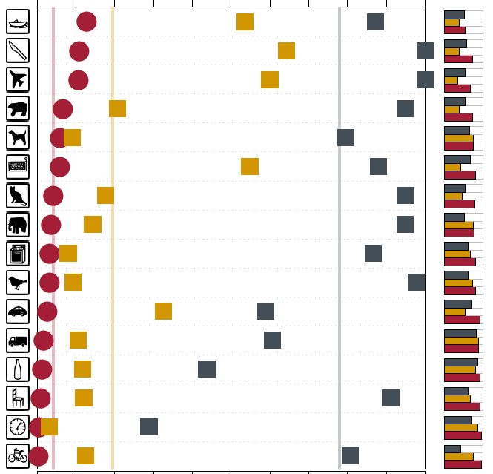
Experiments Setup
shape
texture
ResNet-50 (IN)
ResNet-50 (SIN)
(Geirhos et al., 2019)
13 / 26
Notes:
Not explicitly said in the paper but: - Note that the training on SIN and evaluation on texture-cue conflict ONLY can be done by the shape
Similar results for AlexNet and VGG-16
No data for GoogLeNet since network training was performed in PyTorch – which does not provide a GoogLeNet architecture
(Figure 5)

Slide 39
Results - Overview
1. CNNs (mostly) use textures for the classification task
2. This texture-bias can be replaced by a shape-bias by using a suitable database
(Geirhos et al., 2019)
1 / 26

Slide 40
Results - Overview
1. CNNs (mostly) use textures for the classification task
2. This texture-bias can be replaced by a shape-bias by using a suitable database
3. CNNs with a shape-bias are more robust to (unseen) noise
(Geirhos et al., 2019)
1 / 26

Slide 41
5 Experimental evaluation ResNet-50
Training | top-1 ImageNet [accuracy %] | top-5 ImageNet [accuracy %]
IN | 76.1 | 92.7
SIN | 60.2 | 82.6
SIN + IN | 74.6 | 92.1
SIN + IN (& fine-tuning) | 76.7 | 93.3
(Geirhos et al., 2019)
26 / 26
Notes:
(Table 2)

Slide 42

5 Experimental evaluation ResNet-50
Training | top-1 ImageNet [accuracy %] | top-5 ImageNet [accuracy %] | PASCAL VOC [mAP50 %]
IN | 76.1 | 92.7 | 70.7
SIN | 60.2 | 82.6 | 70.6
SIN + IN | 74.6 | 92.1 | 74.0
SIN + IN (& fine-tuning) | 76.7 | 93.3 | 75.1
Transfer learning
(Geirhos et al., 2019)
26 / 26
Notes:
Pascal VOC: standardised image data sets for object recognition („Visual Object Classes Challenge“)
mAP50 = mean average precision (True positive/ all positives)
50 = IoU = Intersection over union – how much overlaps the predicted boundary [area] with the ground thruth (the real object boundary) [area]
50 = PASCAL VOC threshold to have a positive prediction (at least 50% of the computed boundary overlaps with the real boundary)
(Table 2)

Slide 43

5 Experimental evaluation ResNet-50
Training | top-1 ImageNet [accuracy %] | top-5 ImageNet [accuracy %] | PASCAL VOC [mAP50 %] | MS COCO [mAP50 %]
IN | 76.1 | 92.7 | 70.7 | 52.3
SIN | 60.2 | 82.6 | 70.6 | 51.9
SIN + IN | 74.6 | 92.1 | 74.0 | 53.8
SIN + IN (& fine-tuning) | 76.7 | 93.3 | 75.1 | 55.2
Transfer learning
(2020; https://cocodataset.org/images/coco-logo.png and http://host.robots.ox.ac.uk/pascal/VOC/pascal2.png)
(Geirhos et al., 2019)
26 / 26
Notes:
MS COCO: Object detection, segmentation and captioning dataset („Common Objects in Context“)
For object detection: shape-based decision > texture-based (since the borders of the object align with the shape)
Pascal VOC/ COCO on Faster R-CNN (object detection architecture by Ross Girshick et al., 2015) using YOLO and SSD networks (you look only once, single shot detector)
Similar results for ResNet-152 (table 4)
(Table 2)

Slide 44
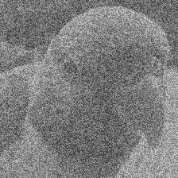
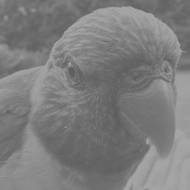
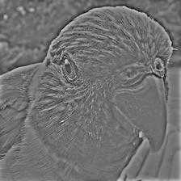

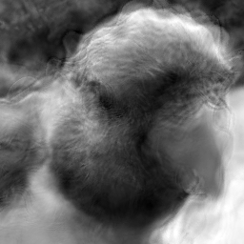
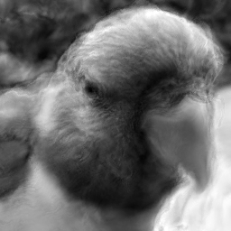
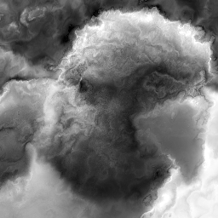
5 Experimental evaluation → RESULT 1
Noise (in the test-data):
Unifom
Low contrast
High-pass filter
Low-pass filter
Eidolon perturbations
(Geirhos et al., 2019)
13 / 26
Notes:
IN-trained CNN generalize poorly towards many distortions ⬅ p.9 Dodge & Karam, 2017, Geiros et. Al. 2017/2018
SIN transfer well!
All distortions reported by Geirhos et al. (2018) with more than five different levels of sigal strength.
Eidolon = disruption of image structure across space and spatial scales
Blurring is still difficult for SIN – maybe because over-representation of high frequency signals in SIN through paintings (WHY DONT FIX THIS?)
More positive results for SIN+IN-training, evaluated on ImageNet-C (Gaussian, Shot, Impulse noise, Defocus, Glass, Motion blur, Snow, Frost, Fog, Contrast, Elastic, Pixelate, JPEG digital corrputions)

Slide 45
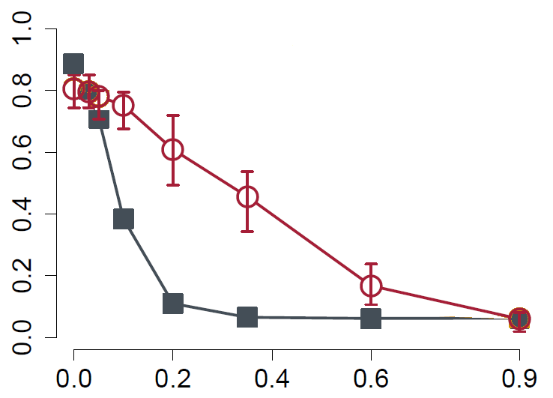
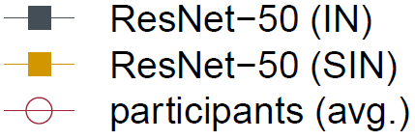


5 Experimental evaluation → RESULT 1
Classification accuracy (%)
Noise strength
(Geirhos et al., 2019)
13 / 26
Notes:
IN-trained CNN generalize poorly towards many distortions ⬅ p.9 Dodge & Karam, 2017, Geiros et. Al. 2017/2018
Eidolon = disruption of image structure across space and spatial scales
All distortions reported by Geirhos et al. (2018) with more than five different levels of sigal strength.
Blurring is difficutl for SIN – maybe because over-representation of high frequency signals in SIN through paintings (WHY DONT FIX THIS?)
More positive results for SIN+IN-training, evaluated on ImageNet-C (Gaussian, Shot, Impulse noise, Defocus, Glass, Motion blur, Snow, Frost, Fog, Contrast, Elastic, Pixelate, JPEG digital corrputions)

Slide 46
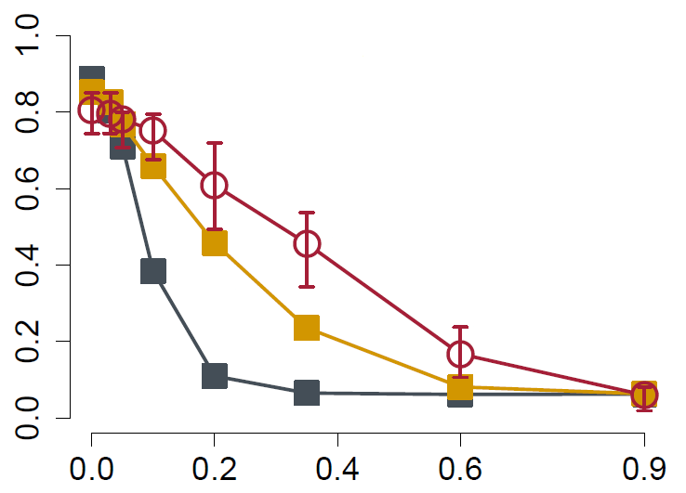
5 Experimental evaluation → RESULT 1
Classification accuracy (%)
Noise strength
(Geirhos et al., 2019)
13 / 26
Notes:
IN-trained CNN generalize poorly towards many distortions ⬅ p.9 Dodge & Karam, 2017, Geiros et. Al. 2017/2018
Eidolon = disruption of image structure across space and spatial scales
All distortions reported by Geirhos et al. (2018) with more than five different levels of sigal strength.
Blurring is difficutl for SIN – maybe because over-representation of high frequency signals in SIN through paintings (WHY DONT FIX THIS?)
Notice that the CNN has never seen these distortions before!!! (TRAINNIG POSSIBILITY)
More positive results for SIN+IN-training, evaluated on ImageNet-C (Gaussian, Shot, Impulse noise, Defocus, Glass, Motion blur, Snow, Frost, Fog, Contrast, Elastic, Pixelate, JPEG digital corrputions)

Slide 47
Conclusion
1. CNNs (mostly) use textures for the classification task
2. This texture-bias can be replaced by a shape-bias by using a suitable database
3. CNNs with a shape-bias are more robust to (unseen) noise
(Geirhos et al., 2019)
1 / 26

Slide 48
Critic (1/2)
How was the performance agains adverserial input? What kind of adverserial input can fool the implementation?
The CNN implementation was switched only for the evaluation of the transfer learning – but the results were set in relation to other implementations without the SIN training. How big of an influence was the Faster-RCNN implementation (by Ren et la., 2017) in these results?
Can the initially expected shape-hierarchy be interpreted as a texture-hierarchy? How does the SIN-CNN looks in the inside? (Deconvolutional NN) What is the possible error in the shape-hypothesis? Does the SIN-CNN perform better on negative images? (Counter example for the shape-hypothesis given by Hossein)
Missing furure work section
Why focus on ResNet-50?
What was done by the „fine tuning“-step for the Shape-ResNet?
(Geirhos et al., 2019)
1 / 26
Notes:
„Humans can learn during the testing“ – not an actual (fixable) problem(?)

Slide 49
Critic (2/2)
Distributed in „related work“ comments
Only ONE cure conflict used: shape-texture Alternative parameters: colour, amount of objects, … This choise could have been commented more
Few (human) experiments per actual category
Idea of SIN: make the texture a noisance, keep the shape intact But as statet by the authors: „a substantial amount“ of output from the style-transfer was not recognizable (non-sense images). Why are there no counter measures? E.g. preserving the edges (p.5. footnote3)
No comment to the Mix-up technique where the desired output gives multiple possibilities for detected objects. Is it possible that different biases lead to categorically different object detections?
(Geirhos et al., 2019)
1 / 26
Notes:
„Humans can learn during the testing“ – not an actual (fixable) problem(?)

Slide 50
Future work
Applications for both biases? Let the shape-bias guess and use texture-bias for verification IF deemed suitable for the object (panter, leopard). Do not dismiss texture information entirely – just don not only rely on it. It did a brilliant job so far.
Other applications besides object detection, e.g. semantic segmentation … TODO
Takle the texture-bias in other ways: Different changes or selections of the database, changes to the CNN architecture, use of loss functions, … Combine different approaches.
(In general: Answering open questions, e.g. given in my critic above.)
(Geirhos et al., 2019)
1 / 26

Slide 51
Bibliography
TODO
(Geirhos et al., 2019)
1 / 26

Slide 52
Thank you for your attention!

Slide 53
Appendix Other slides

Slide 54
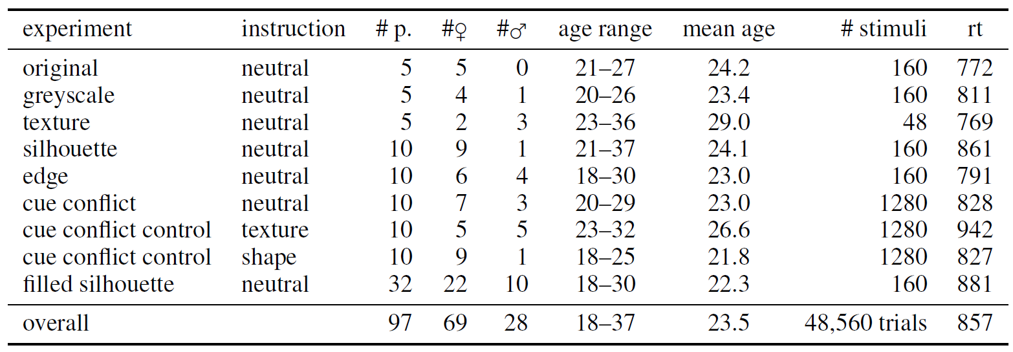
Experiments Setup
TODO
(Geirhos et al., 2029)
13 / 26

Slide 55
5 Experimental evaluation
26 / 26

Slide 56
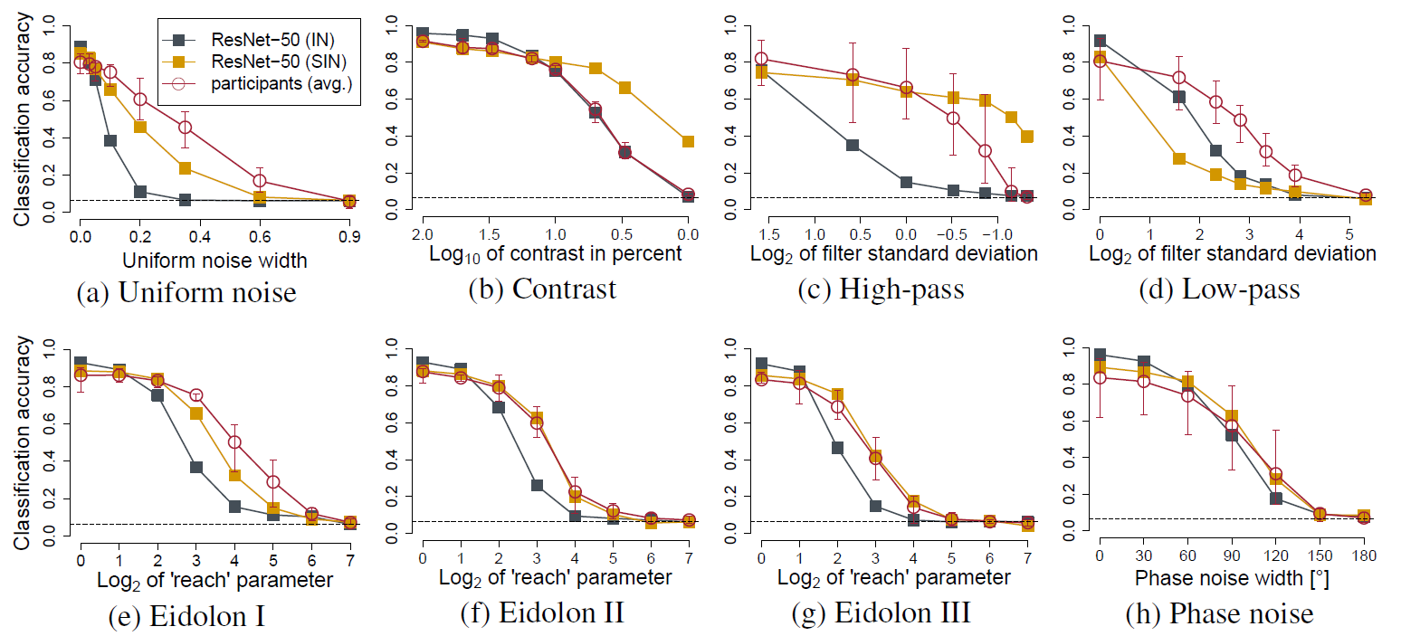
5 Experimental evaluation
26 / 26

Slide 57
Method
Terminology
DEF: feature = attribute learned by CNN
DEF: cue = physical attribute
Idea: Reduce the the relation of present textures with the solution – for testing and or training (If the performance of the CNNs drops but not the performance of the human, this could indicate that the CNN classify using a different approach. Quantify the texture & shape biases in human & CNN)
Use texture-cure conflics
1 / 26

Slide 58
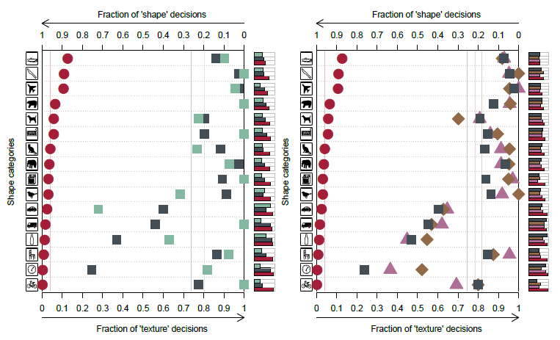
5 Experimental evaluation
TODO: Figure 1, 2, 4
Both good: natural, greyscale, texture
CNN bad: silhouette, edges (= “object shape”) ➔ CNNS difficulties from natural to sketch
26 / 26

Slide 59
ImageNet-trained CNNs are biased towards texture; increasing shape bias improves accuracy and robustness )
1995 by Yann LeCun and Yoshua Bengio
Notes:
AlexNet
(KRIZHEVSKY, Alex; SUTSKEVER, Ilya; HINTON, Geoffrey E. Imagenet classification with deep convolutional neural networks. In: Advances in neural information processing systems. 2012. S. 1097-1105.)

Slide 60
Task(s)
TASK: Elaborate what exactly a CNN does learn –
if the ImageNet database is used
Result: 1. The CNN did learn (mostly) use textures for the classification task
Subtask: Can and should this texture-biased learning be avoided?
Solution: 2. Yes it can be avoided by using a modified database
3. Avoiding it this way leads to an improved method
1 / 26

Slide 61
Method
Terminology
DEF: feature = attribute learned by CNN
DEF: cue = physical attribute
Idea: Assume that both CNN and humans rely on shape (shape being a feature and a cue). Now present images with clear shapes but a contradicting cue (in this case texture).
→ Use texture-shape cue conflicts
1 / 26
Notes:
If performance of CNNs is BAD: Shape is not an important feature (because it is still detectable)
If performance of CNNs/human is GOOD: The contradicting cue is not an important feature - because the detectable shape was sufficient for the classification.
Quantify the texture & shape biases in humans & CNN

Slide 62
Method
DEF: texture-shape cue conflict:
“style-transfer“
(Gatys et al., 2016)
(Geirhos et al., 2029)
1 / 26

Slide 63
Experiments Setup
9 Experiments:
13 / 26
Notes:
9 Experiments (PIE CHART?)
6 major
5: object recognition, different available features (Figure 2)
1: Cue conflices (Figure 1, S. 4)
3 control

Slide 64
Experiments Setup
x160
x160
x160
x160
x1280
Original
Greyscale
Silhouette
Object shape
Texture
13 / 26

Slide 65
5 Experimental evaluation
BOTH
BOTH
HUMANS
HUMANS
BOTH
HUMANS
x160
x160
x160
x160
x48
Original
Greyscale
Silhouette
Object shape
Texture
Texture-shape cue conflict
1. Result: The CNNs used textures for the classification task.
They have problems to shift from natural images (training data) to sketches
(Geirhos et al., 2029)
13 / 26

Slide 66
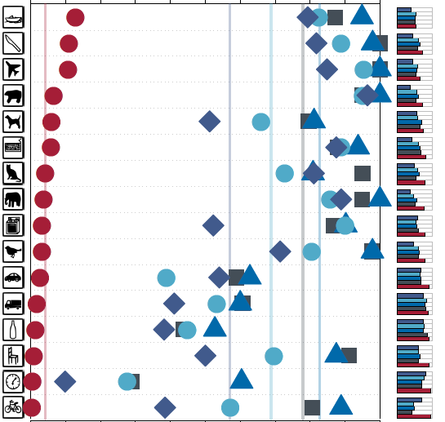
Experiments Setup
cat
Fraction of `shape‘ decisions
1.0 | 0.9 | 0.8 | 0.7 | 0.6 | 0.5 | 0.4 | 0.3 | 0.2 | 0.1 | 0.0
Shape categories
elephant
13 / 26

Slide 67
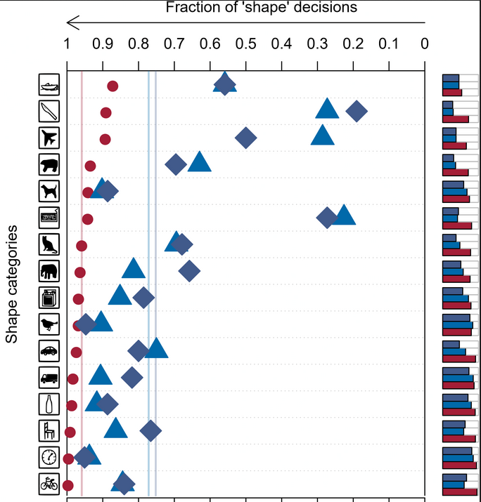
Experiments Trained on SIN – AlexNet and VGG-16
cat
Fraction of `shape‘ decisions
1.0 | 0.9 | 0.8 | 0.7 | 0.6 | 0.5 | 0.4 | 0.3 | 0.2 | 0.1 | 0.0
elephant
13 / 26

